Slide 1
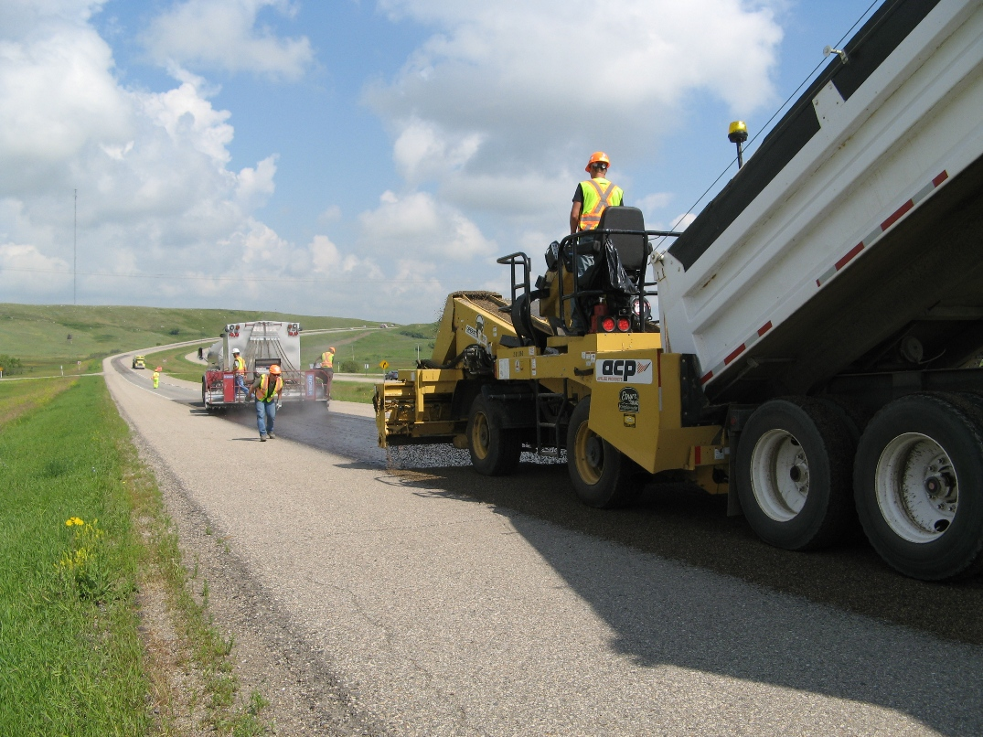
Low Volume Road Solutions
By: Jason Panter
Notes:
Hi I’m Chris Dechkoff from ACP Applied products
The title of my presentation is Low Volume Road Solutions

Slide 2
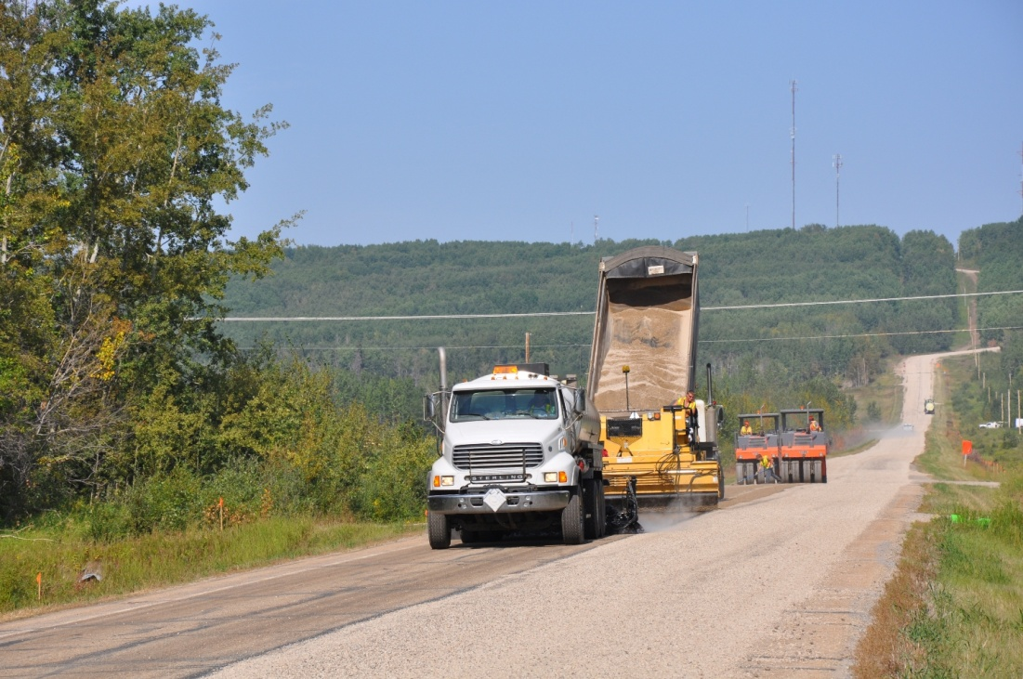
Seal Coats
What is a Seal Coat?
Thin surface treatments
Binder & Aggregates
Notes:
So what does it mean to have a seal coat?
A collective term for several different kinds of thin surface treatments.
Applications of asphalt material that is usually covered with aggregates.

Slide 3
Seal Coats
Why are Seal Coats Used?
Protect structure
Improve texture
Correct non-structural deficiencies
Aged or oxidized pavement
Cracking
Raveling
Lack of skid resistance
Wearing Course
Dust Control
Notes:
Why are Seal Coats used and what benefit do they have?
Used to protect pavement or substructure from water infiltration
Improve surface texture (increase skid resistance)
To correct non-structural deficiencies
Aged or oxidized pavement
Cracking
Raveling
Lack of skid resistance
Provide a wearing course over a base or porous product
Works well as dust control while providing a solid wearing course

Slide 4
Gravel Seals
High Float asphalt emulsion
Unwashed graded aggregate (gravel).
Wearing and water-proofing course.
Applied to a variety of surfaces:
Sub-grade
Base
Pavement
Stabilized Bases
Graded-aggregate
Binder
Unprimed substrate
Notes:
An application of High Float asphalt emulsion followed by an application of unwashed graded aggregate.
Primarily used as a wearing and water-proofing course.
Can be applied to a variety of surfaces:
Sub-grade
Base
Pavement
Stabilized bases

Slide 5
Gravel Seals
How to build one
Emulsion layer sprayed first
Aggregate layer evenly distributed
Packed for orientation
Repeat
Compacted Gravel Base
Notes:
So how does one go about building a gravel seal? Either a single or a double seal.
The concept of gravel seal is as illustrated on this slide.
First off the gravel base or substrate that the seal is to be placed on must be compacted properly and shaped to the desired profile
Next the binder is placed onto the granular base or substrate then the aggregate (gravel) layer is distributed evenly
The placement process to this point is identical to conventional chip seals.
With rolling the low viscosity emulsion percolates into the aggregate matrix upwards and also downwards and helps orientation of the particles
Here you have a completed single gravel seal
This process is then repeated to construct a double gravel seal.

Slide 6
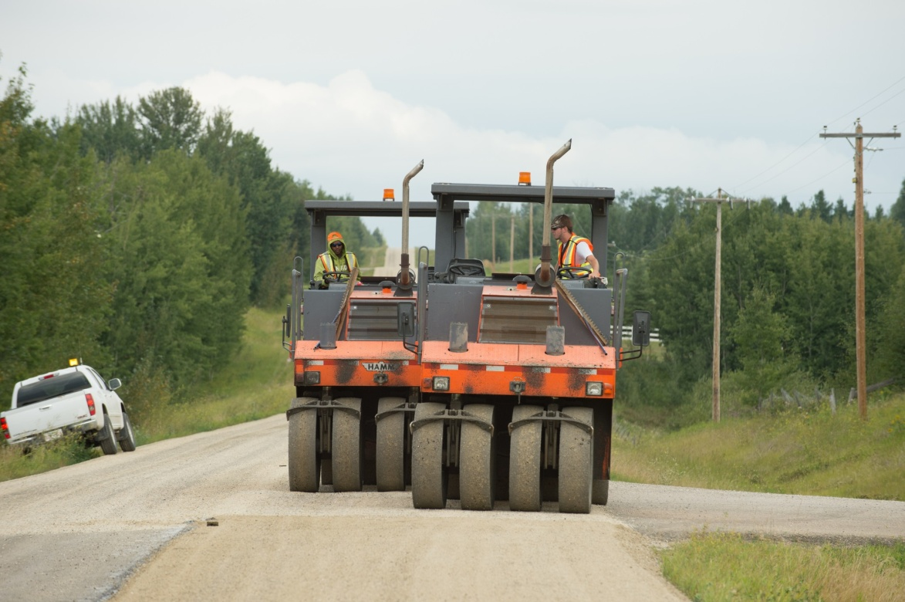
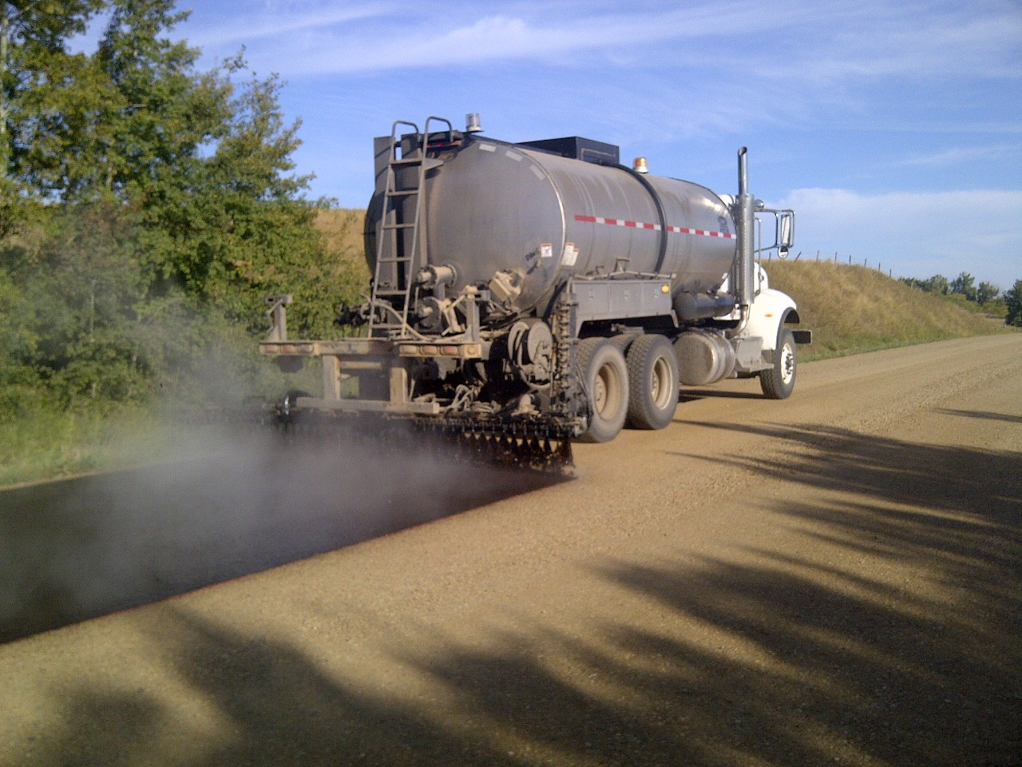
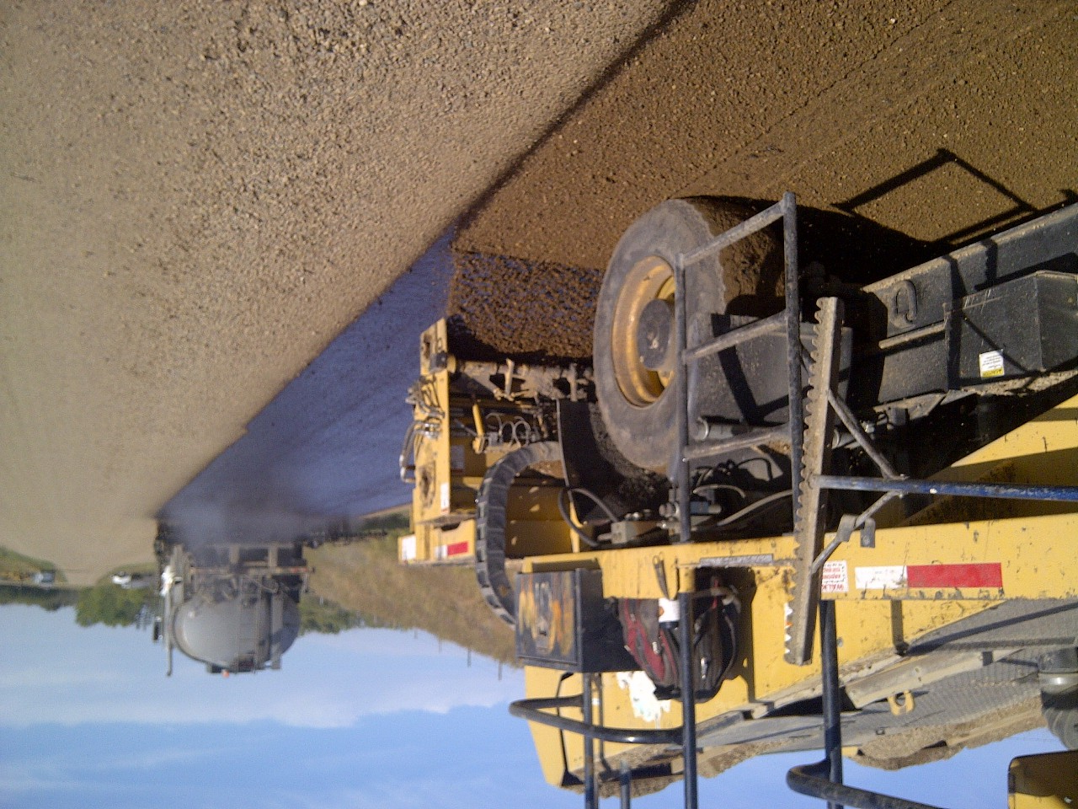
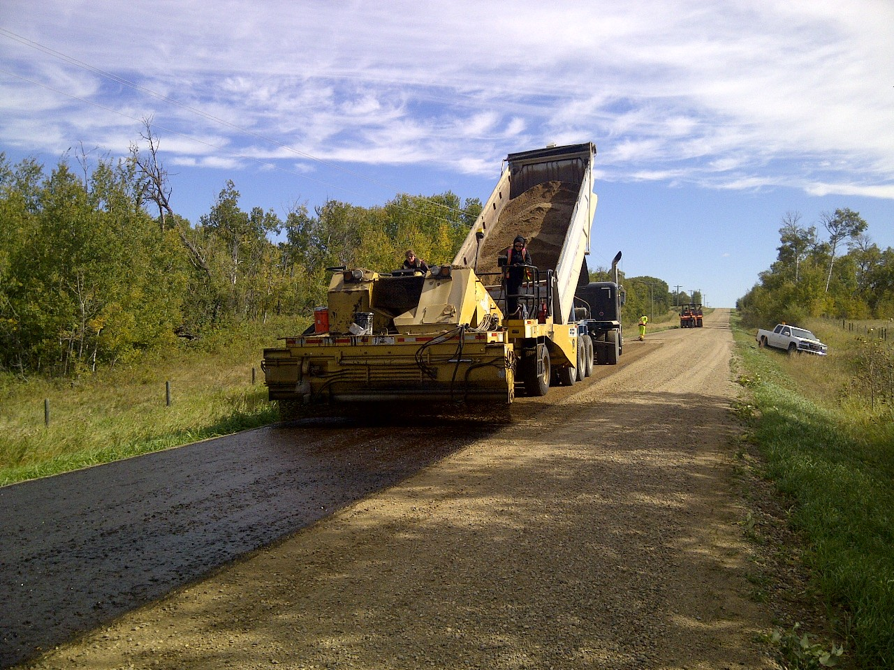
Gravel Seals
Notes:
Graded Seal Coat Application and Construction in Provost, Alberta

Slide 7
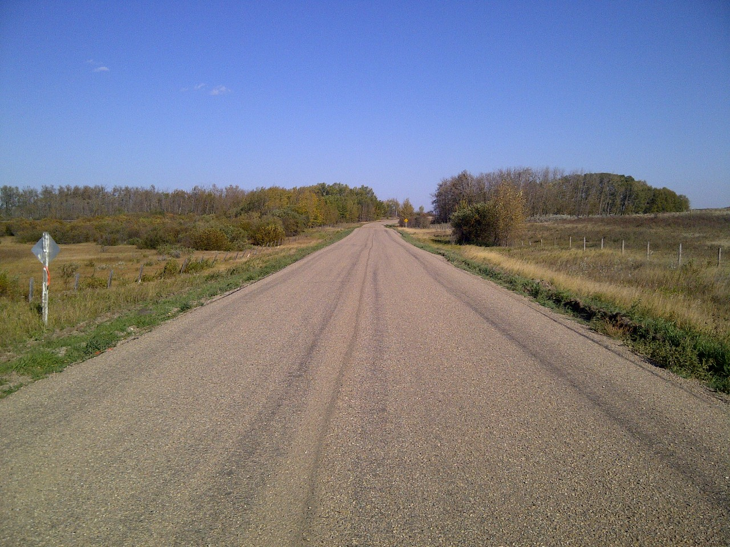
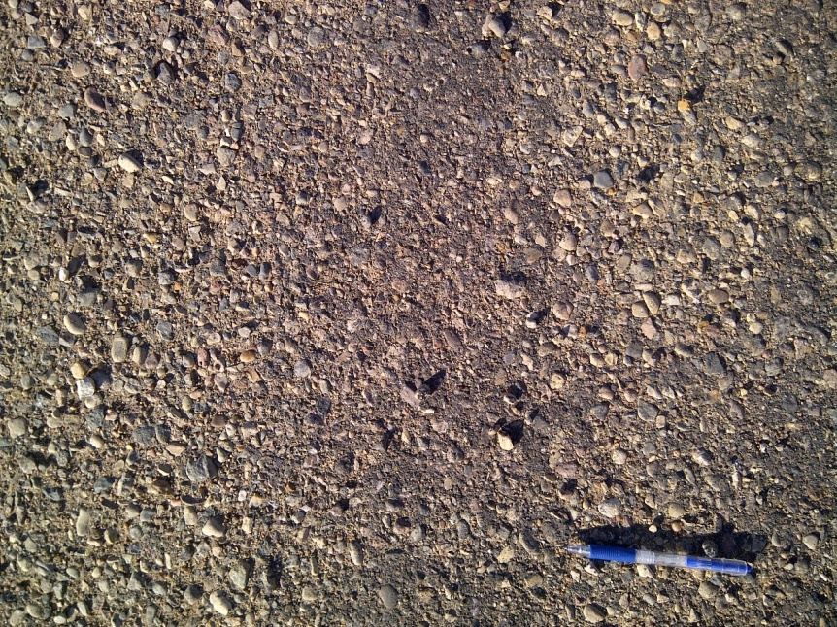
Gravel Seals
Notes:
Here is an example of a double gravel seal on a compacted gravel base after initial construction for the MD of Provost
The road surface is quite rough but with traffic and time the surface will knead together

Slide 8
Fibermat Option
Direction of Application
Chopped fibres
Chippings
First layer of emulsion
Second layer of emulsion
Notes:
This is a diagram that shows all the main element of the trailer unit including the space within the trailer for the storage of spools of fibre, the conduits that bring the stands of fibre to the chopping units and chamber.
The diagram also shows the two spray bars located in front and behind the fibre distribution unit.
Chippings are then applied on top of the fibre-reinforced membrane and embedded into the binder to form a fibre-reinforced surfacing or interlayer system.
The trailer unit contains sufficient fibre in storage for the placement of 40,000 m2 of fibre-reinforced membrane before re-loading. The width of placement can vary from 3.0 to 4.0 m.

Slide 9
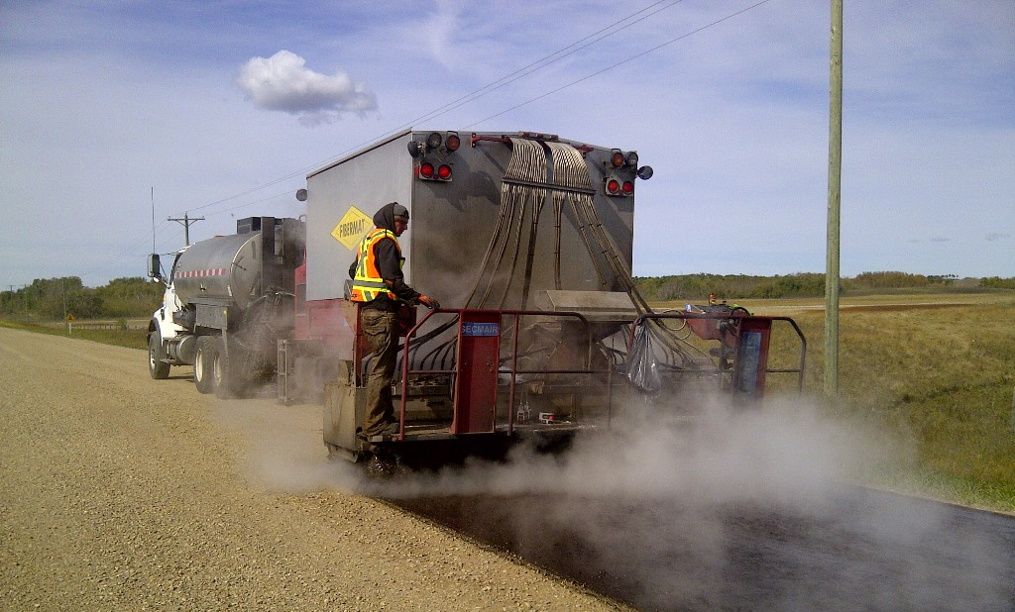
Fibre Option
First Application of binder
Application of Fibres
(60mm length at 75 g/m²)
Second Application of binder

Slide 10
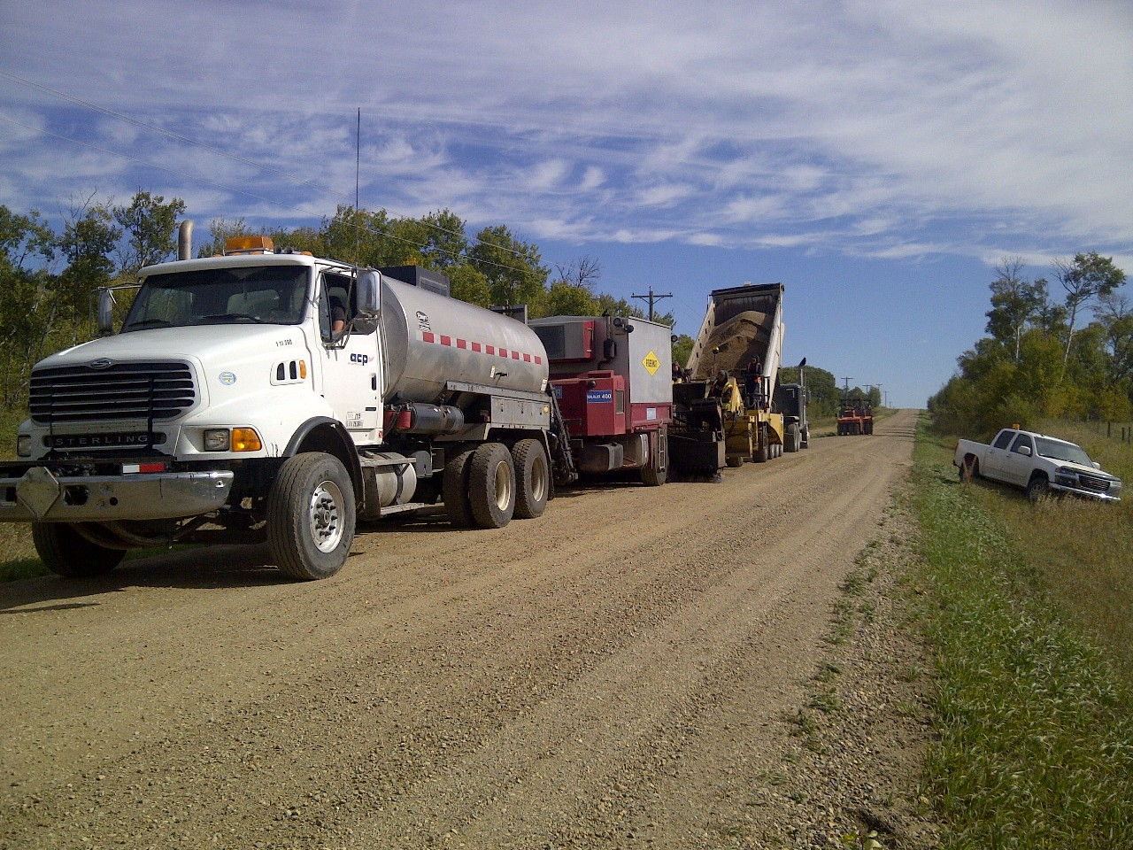
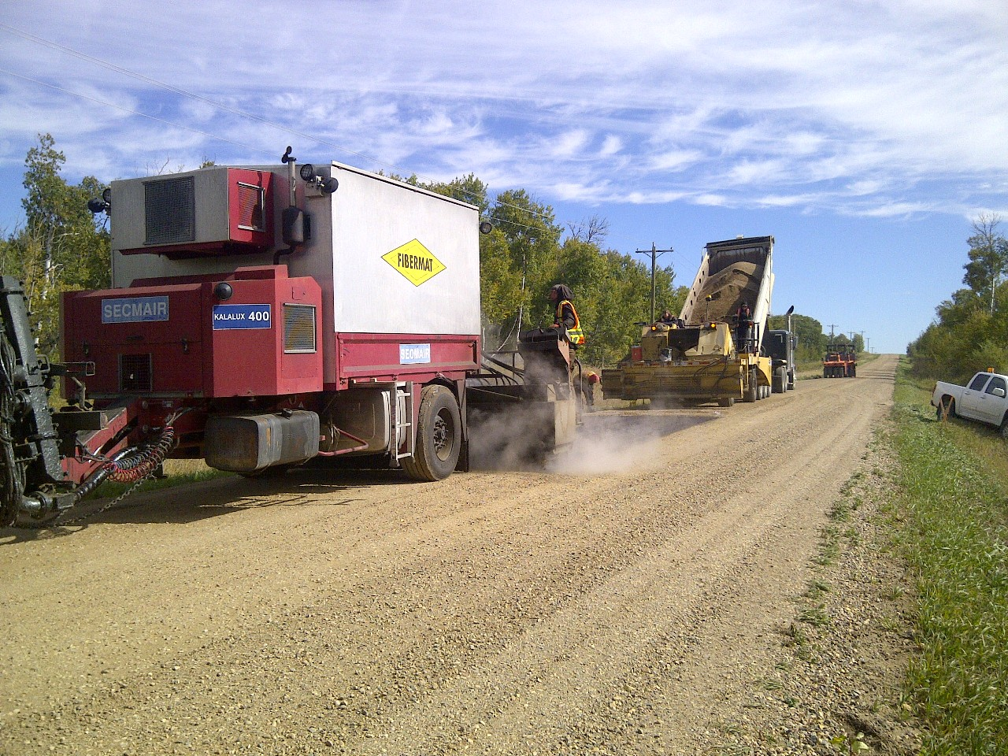
Fibermat Option
(Double Gravel Seal)
Notes:
Fibermat can be utilized as an addition to most seal coat operations.
Here it can be seen being utilized in a double gravel seal on the initial application directly on the compacted gravel base for the MD of Provost
Fibermat can be used in multi-chip applications as well as single applications.

Slide 11
Fibermat Option
Notes:
Here is a quick video of the Fibermat operation.
As is evident in the video the operation does not slow down the application process of the binder and operates much like a traditional seal coat process.

Slide 12
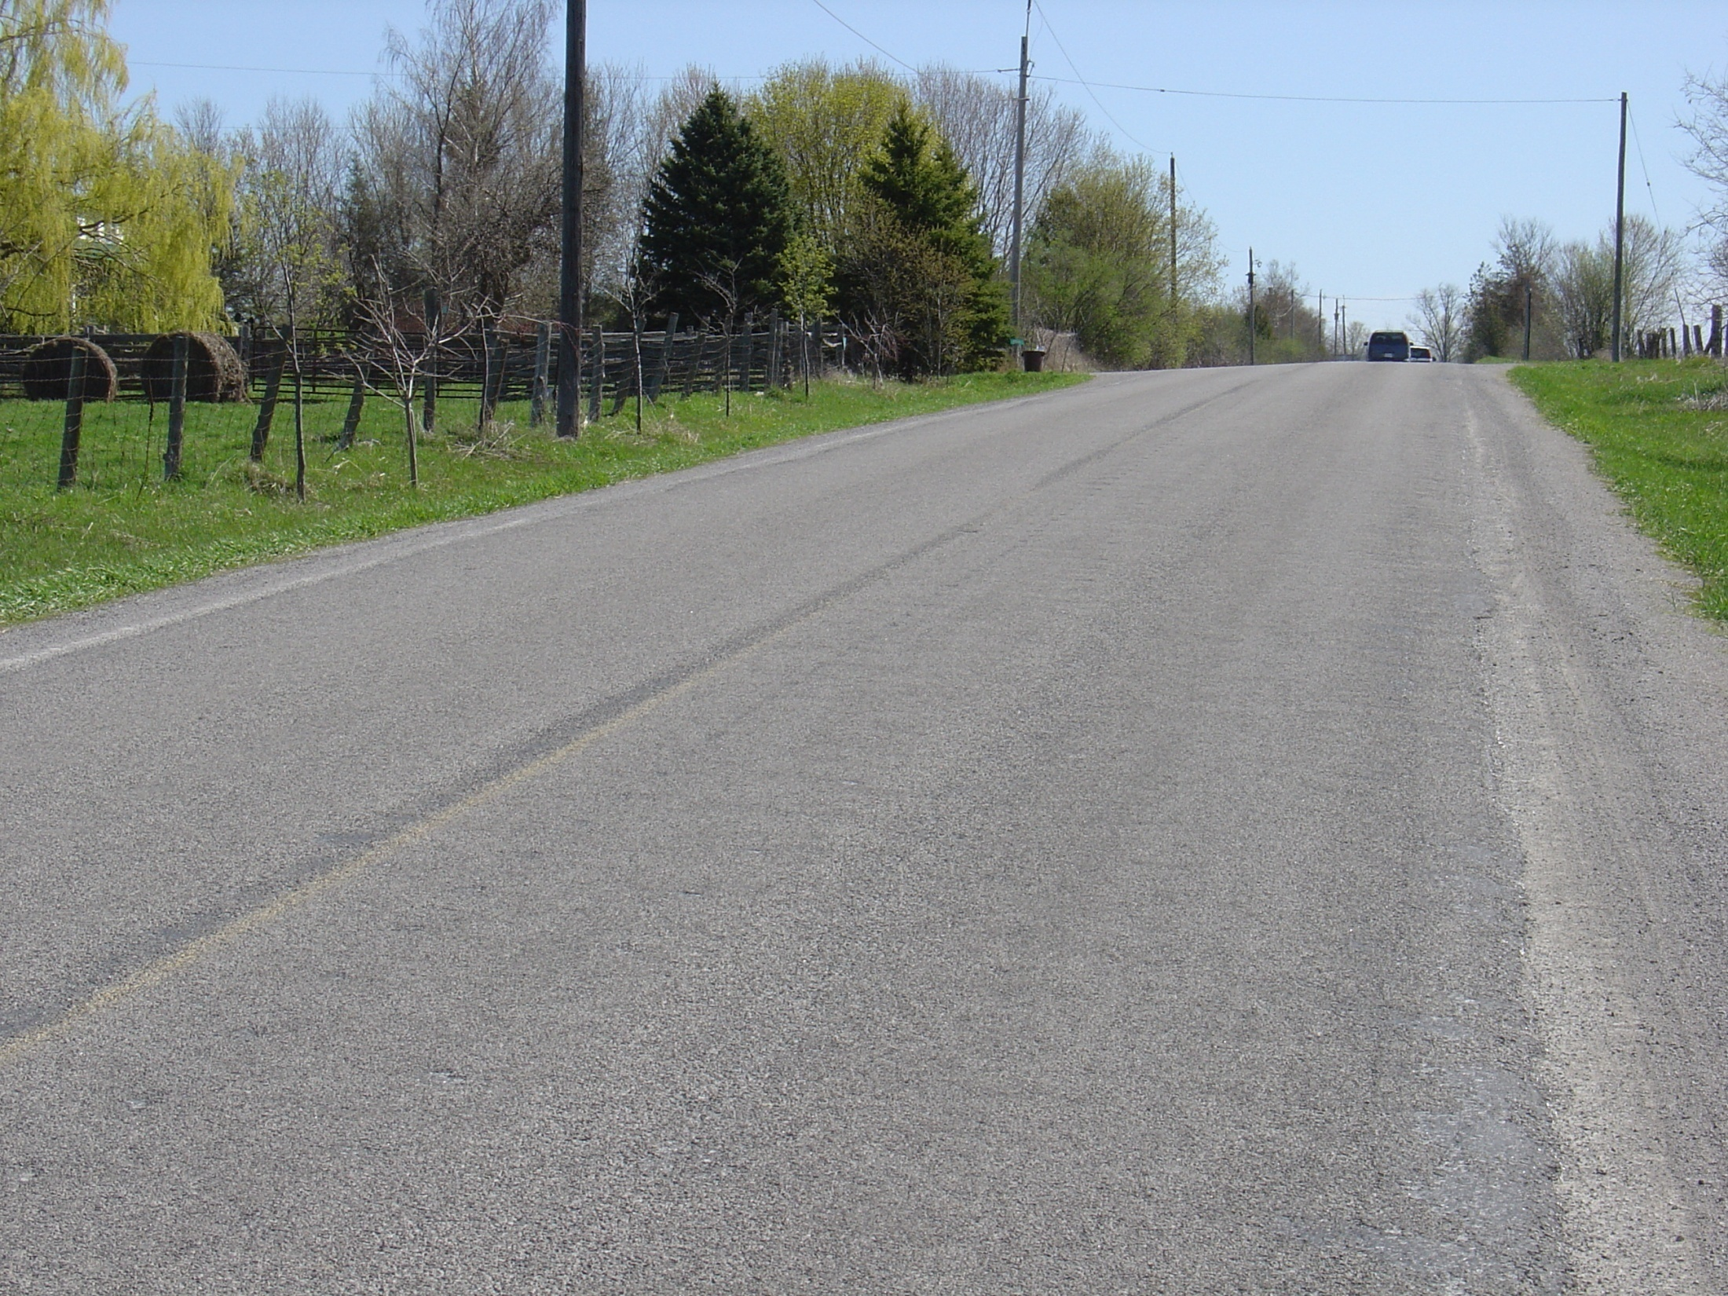
Fibermat Option
Notes:
Here is an example of what a section of roadway looks like with the addition of Fibermat.
Upon initial investigation it looks like any other seal coated road.
It will not be until further years when maintenance of these roads is reduced that it will become evident that it possesses Fiber.

Slide 13
Performance
Notes:
Double GravelSeal Coat with Fibre
This is the first double gravel seals with fibre-reinforcement applied on a public roadway.
The work was carried out in 2011 in Macklin, Saskatchewan.

Slide 14
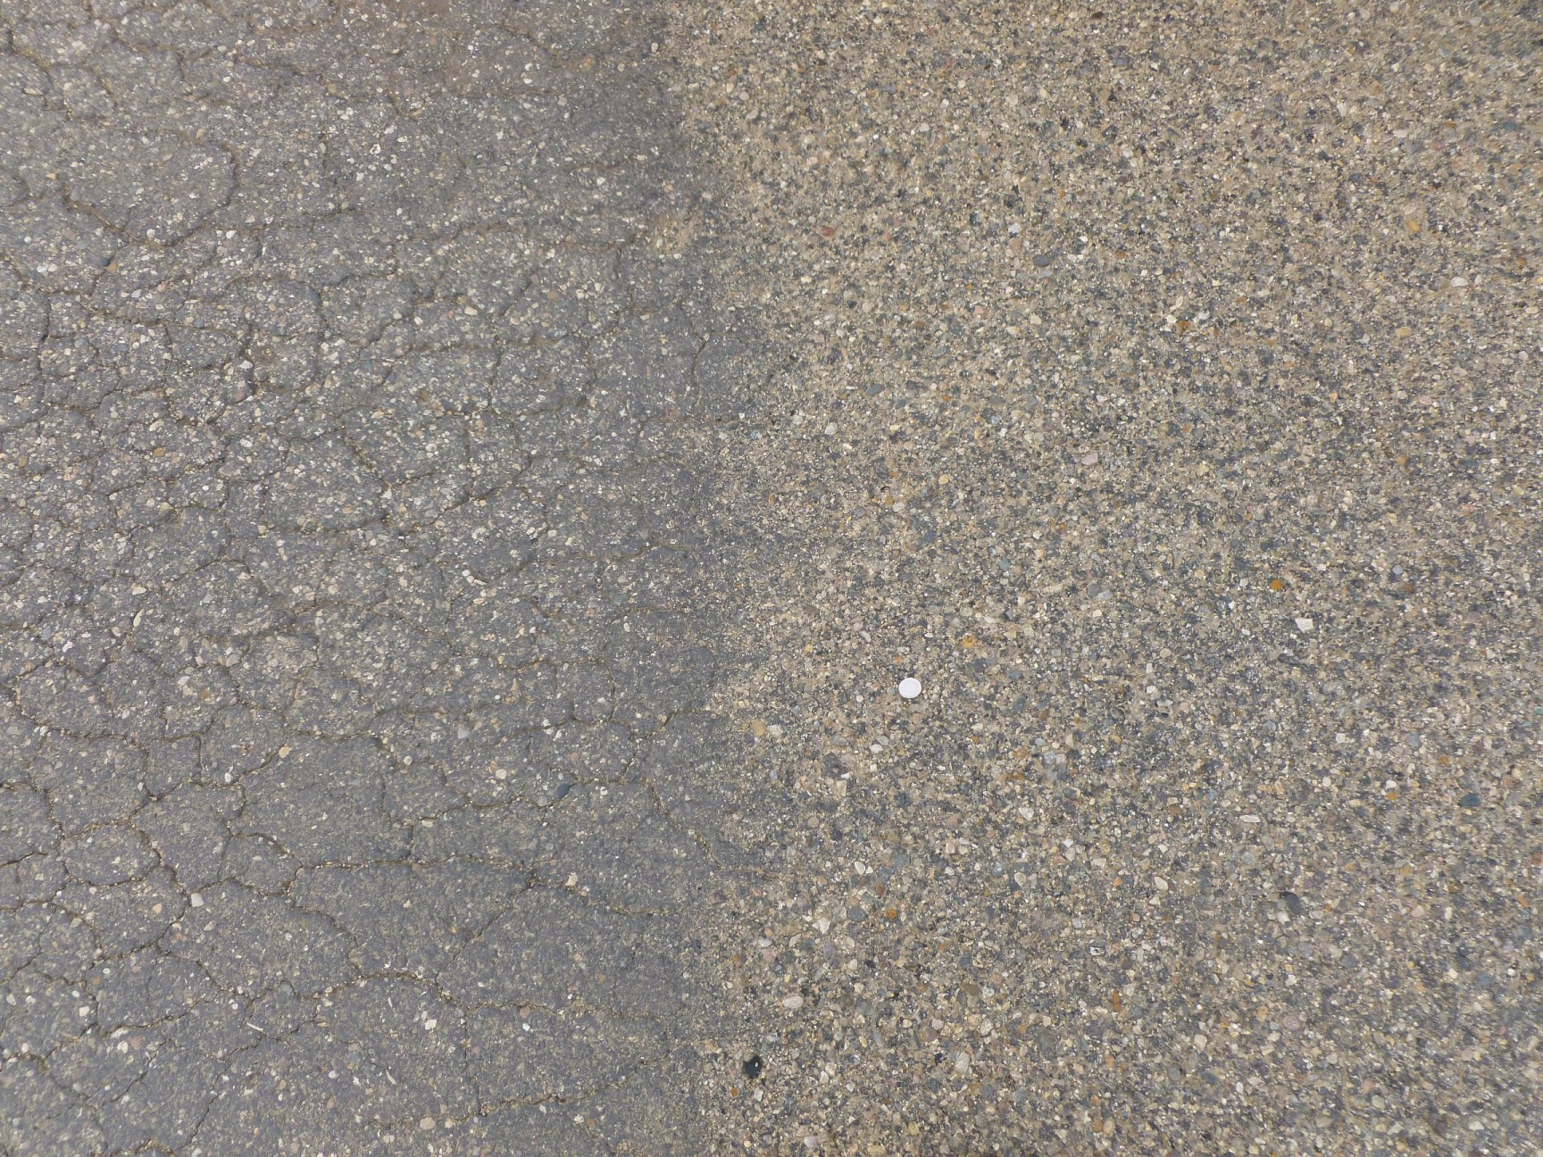
Performance
Before
After
Notes:
Double GravelSeal Coat with Fibre

Slide 15
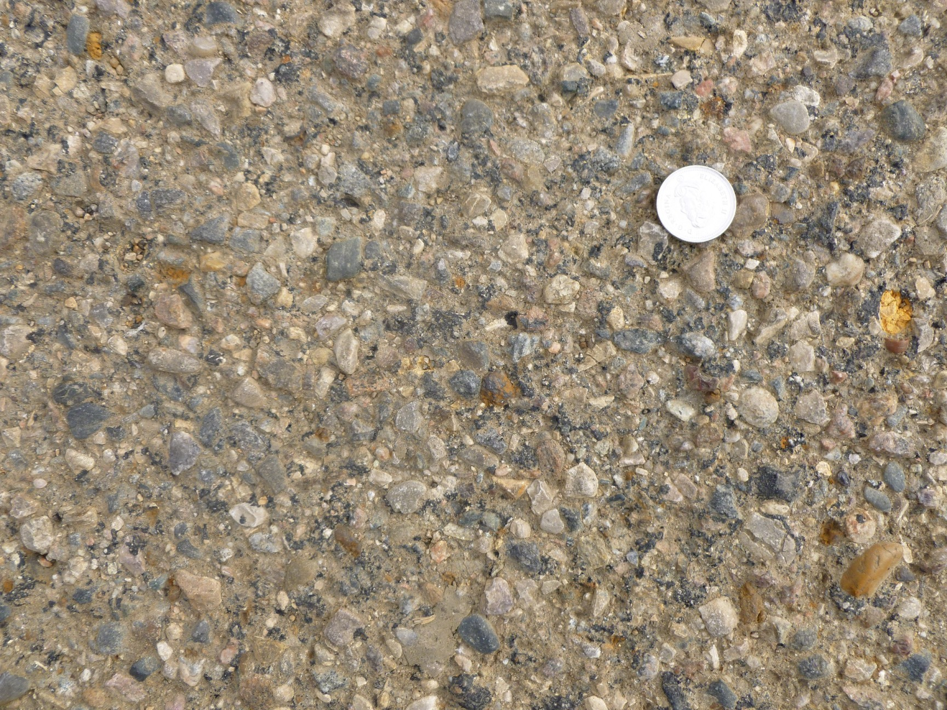
Performance
Before
After
Notes:
Double Gravel Seal Coat with Fibre

Slide 16
Performance
Aggregate Req’d: 600 MT/km
Type: 12.5C Gravel
Binder : HF150P

Slide 17
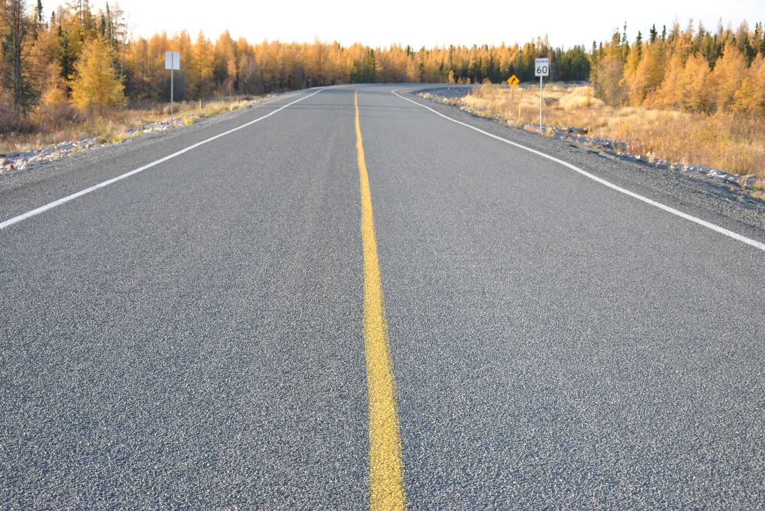
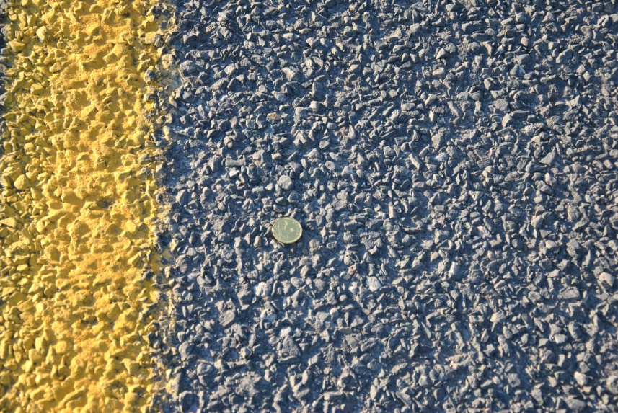
Performance
Notes:
This is also a double gravel seal with fibre-reinforcement.
The work was carried out in 2010 in the Northwest Territories near Yellowknife in 2010.
The picture shown here was taken only a few weeks ago.

Slide 18
Ballpark Pricing
Single with Fiber (Supply) = $4.00 - $6.00
Single No Fiber (Supply) = $3.00 - $4.00
Single with Fiber (No Supply) = $3.00 - $5.00
Single No Fiber (No Supply) = $2.00 - $3.00
Double with Fiber (Supply) = $7.00 - $9.00
Double No Fiber (Supply) = $6.00 - $8.00
Double with Fiber (No Supply) = $6.00 - $8.00
Double No Fiber (No Supply) = $5.00 - $6.00

Slide 19
Offering
Produce our own Emulsions
Aggregate Testing
Seal Coat and Cold Mix Designs
Construction
Solutions for your road networks

Slide 20
Questions?
Chris Dechkoff, P.Eng.
cdechkoff@acpapplied.com
www.acpapplied.com

